Slide 1
Blockchain Technology

Slide 2
Agenda
Ledger and its types
High-level use cases for blockchain
Smart Contract and its use cases
Types of block chains
Problems solved by blockchain
Supply Chain Use cases of blockchain.

Slide 3
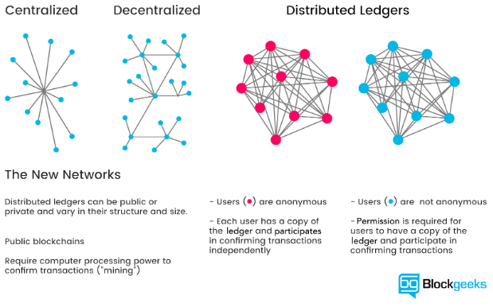
Ledger
Ledger is a physical/ digital file for recording economic transactions
Types:

Slide 4
High-level use cases for blockchain
Supply Chain Interoperability / Visibility
Financial Services
Healthcare / Medical
Academia / Publishing
Agriculture
Crowd-funding

Slide 5
Smart Contract
Contract: a written or spoken agreement that is intended to be enforceable by law.
Smart contracts help you exchange anything of value in a transparent, conflict-free way while avoiding the services of a middleman.
Ethereum vs. Hyperledger
Use cases:
Axa’s flight delay insurance – Automatic reimbursement
A consortium between Walmart, IBM and Tsinghua University in Beijing in supply chain management.
Ascribe is an example of a use of a smart contract for the intellectual property

Slide 6
Types of block chains
Blockchain
World state
Block
Smart contract
Distributed ledger
Consensus
Types of blockchain:
Public blockchains
Private blockchains
Consortium blockchains

Slide 7
Problems solved by Blockchain
Transparency
Decentralization
Secure
Immutability
Cost and Time efficiency
Middleman fees cut-down

Slide 8
Supply Chain Use cases.
Bext360- Coffee supply chain
Natureta
nVipani
BTC logistic Centre

Slide 9
Tiny blockchain in JS
const sha256 = require('sha256');
class Block {
constructor(index, timestamp, data, prevHash) {
this.index = index;
this.timestamp = timestamp;
this.data = data;
this.prevHash = prevHash;
this.thisHash = sha256(
this.index + this.timestamp + this.data + this.prevHash
);
}} const createGenesisBlock = () => new Block(0, Date.now(), 'Genesis Block', '0');
const nextBlock = (lastBlock, data) =>
new Block(lastBlock.index + 1, Date.now(), data, lastBlock.thisHash);
const createBlockchain = num => {
const blockchain = [createGenesisBlock()];
let previousBlock = blockchain[0];
for (let i = 1; i < num; i += 1) {
const blockToAdd = nextBlock(previousBlock, `This is block #${i}`);
blockchain.push(blockToAdd);
previousBlock = blockToAdd;
}
console.log(blockchain); };
const lengthToCreate = 20;
createBlockchain(lengthToCreate);

